Slide 1
Mycetoma In Sudan
  Prof. Ahmed M. EL Hassan
  Emeritus Professor of Pathology
  Mycetoma Research Group
  Institute of Endemic diseases
  University of Khartoum

Slide 2
Objectives
The objectives of this presentation are to describe and discuss:
  The history of mycetoma research and services on mycetoma in Sudan
  The clinical features, pathology and immunopathology of M. mycetomatis in Sudan
  The strategies used by the fungus to evade these responses
  Describe the structure of the causative agent at the light and ultrastructural levels.

Slide 3
Rationale
Until recently very little was known about the detailed pathology, pathogenesis and immunopathology of mycetoma.
An understanding of these processes and a proper characterisation of the host/ mycetoma agent interaction may
    explain the chronicity of mycetoma and may
    help in the development of better therapeutic and preventive interventions

Slide 4
History of Research & Services on
Mycetoma In Sudan.
The term mycetoma was created by a Professor of Anatomy and Physiology called Carter when he was working in India
Before that the term Madura foot was used because the disease was prevalent in the district of Madura in India
Several cases were documented in India over the years. An author named Carter published a monograph called “On Mycetoma or Fungal Disease of India” in 18174

Slide 5
History of Research & Services on
Mycetoma In Sudan.
Mycetoma has a world-wide distribution. It is endemic in many tropical and subtropical countries that include Sudan, Somalia, Senegal, India, Yemen, Mexico, Venezuela, Columbia, Argentina and others.
The causative organisms in Sudan include Madurella mycetomatis, Streptomyces somaliensis, Actinomadura madurae and Actinomadura pelletieri.
M. mycetomatis is the most common cause of mycetoma in Sudan and is difficult to treat.

Slide 6
Pioneers On Mycetoma In Sudan
Balfouer
In 1904 was the first to report on a case of mycetoma in the Sudan.
He noted that the disease was common amongst Northern Sudanese
the foot was affected most and
the commonest type was the black grain variety.

Slide 7
Pioneers On Mycetoma In Sudan
Extensive studies of the two causal organisms were carried out by Dr. Albert Chalmers, Director of the Wellcome Tropical Research laboratories, together with
Captain R.G. Archibald, pathologist and
Dr. J.B. Christopherson, Director of Khartoum and Omdurman Civil Hospitals.

Slide 8
Pioneers On Mycetoma In Sudan
They carried out valuable systemic mycological and pathological studies of the causal organisms.
Chalmers and Archibald gave quite an elaborative and specific definition of mycetoma. For the first time they introduced the terms Maduromycoses and Actinomycoses,
proceeded afterwards to classify the mycetomas into Maduromycetoma the grains of which are composed of large segmented mycelia and Actinomycetoma with grains composed of fine non-segmented filaments.

Slide 9
Pioneers On Mycetoma In Sudan
In 1931, Grantham-Hill,
The senior surgeon, Khartoum Hospital made a detailed clinical study of 184 cases out of which 64% were of the black variety and 36% were yellow.
Noting that the yellow type is actinomycotic and the black type is maduromycotic, he discussed the relative virulence of the two types.
He thought that the actinomycotic mycetoma was more virulent, infiltrates gradually and once it penetrates the periosteum it disseminates rapidly in bone while the black maduromycotic mycetoma forms a localized usually subcutaneous tumour.
He doubted the value of medical treatment by various drugs suggested up to that date.

Slide 10
Pioneers On Mycetoma In Sudan
Grantham-Hill thought that the best routine treatment was surgical, and that the key to success lies in early recognition and complete removal.
In the case of black maduromycosis the pseudo-capsule can readily be identified by its bluish colour and dissection follows its outer surface.
In the absence of sinuses an incision is made into the tumour to identify its nature. If it is found to be mycetoma, fresh instruments are taken and a circumscribing incision made at a distance at about one centimeter from the apparent margin of the growth.

Slide 11
Pioneers On Mycetoma In Sudan
Peter Abbott, a surgeon in Wad Medani Civil Hospital was awarded the degree of M.D. (1954) from Cambridge University on his Clinical and Epidemiological Studies of Mycetoma.
He also addressed the Royal Society of Tropical Medicine and Hygiene in London in December 1956 on mycetoma in Sudan.
Abbott sent specimens from his cases abroad to Dr. Walker's Mycological Reference Laboratory in the London School of Hygiene and Tropical Medicine and to Professor Juan E. MacKinnon in Montevideo in Uruguay for mycological identification.

Slide 12
Pioneers On Mycetoma In Sudan
Abbott carried out in vitro trials with antibiotics against Madurella mycetomi and Streptomyces somaliensis.
He found that the growth of M. mycetomi was unaffected by chloramphenicol, oxytetracycline, carbomycin and polymyxin B.
S. somaliensis was markedly sensitive to all these antibiotics except Polymyxin B.

Slide 13
Pioneers On Mycetoma In Sudan
Mahgoub 1964 published for the first time an article on the serological diagnosis of mycetoma.
He also obtained a Ph.D. (1965) on Mycotic Infections in the Sudan, the major part of which was a mycological and serological study of mycetoma.

Slide 14
Pioneers On Mycetoma In Sudan
Mr. Ibrahim Moghraby (1967)
worked for many years as a surgeon in Wad Medani Hospital, centre of endemic area for mycetoma,
presented to the 6th Arab Medical Conference in Khartoum a study on "Mycetoma in the Gezeria, a public health problem".

Slide 15
More Recent Workers on Mycetoma
Collaboration in research between Britain and Sudan in mycetoma started in the late 1960s as collaboration between
Ministry of Overseas Development, UK
WHO
Faculty of Medicine, University of Khartoum
Sudan Ministry of Health

Slide 16
More Recent Workers on Mycetoma
A well-equipped laboratory was established at the Department of Microbiology of the Faculty of Medicine.
Beds were made available for the project at Khartoum North Hospital.
The project addressed epidemiology, clinical manifestations, diagnosis and treatment of mycetoma.
The Director and initiator of the project was Professor EL Sheikh Mahgoub, Professor of Microbiology, Faculty of medicine, University of Khartoum, assisted at the time by Dr. Samia Gumaa who later became a Professor in the department.

Slide 17
More Recent Workers on Mycetoma
Mahgoub 1964
published for the first time an article on the serological diagnosis of mycetoma.
He also obtained a Ph.D. (1965) on Mycotic Infections in the Sudan, the major part of which was a mycological and serological study of mycetoma.

Slide 18
More Recent Workers on Mycetoma
The Mycetoma Research Centre
In 1991 a Mycetoma Research Center was established by Professor Ahmed Hassan Fahal at Soba University Hospital of the University of Khartoum.
Professor Fahal, known for his meticulous attention to detail, established wards and a laboratory in the center.
I was working closely with Prof Fahal in his Research Center

Slide 19
More Recent Workers on Mycetoma
Mycetoma Research Centre
The research included epidemiology, new diagnostic procedures and treatment modalities.
New strains of S. somaliensis were discovered. This was in collaboration with Professor M. Goodfellow of the University of Newcastle.

Slide 20
More Recent Workers on Mycetoma
Collaboration between Britain and Sudan
More recent workers on mycetoma: Collaboration between Britain and Sudan
Nine strains isolated from mycetoma patients and labeled as Streptomyces somaliensis were the subject of a polyphasic taxonomic study.
The organisms shared chemical markers consistent with their classification in the genus Streptomyces and formed two distinct monophyletic subclades in the Streptomyces 16S rRNA gene tree.
A draft Genome Sequence of the human pathogen Streptomyces somalienses, a significant cause of Actinomycetoma was recently published by the same group.

Slide 21
More Recent Workers on Mycetoma
Collaboration between the Netherland and Sudan
More recent workers on mycetoma: Collaboration between Britain and Sudan
The collaboration between the Mycetoma Research Center and the Netherland was initiated by Prof Fahal and Dr. EE Zijlstra who was then a Visiting Lecturer at the IEND.
He was supported by Professor H. Verbrugh and Professor van Belkum of the Department of Medical Microbiology and Infectious Diseases, Erasmus Medical Centre, Rotterdam University, The Netherlands.

Slide 22
More Recent Workers on Mycetoma
Collaboration between the Netherland and Sudan
More recent workers on mycetoma: Collaboration between Britain and Sudan
Several projects that addressed various aspects of mycetoma were initiated.
Dr. A O Ahmed from Khartoum and Dr. van de Sandy from Rotterdam obtained their PhDs from Rotterdam University.
They are now leading scientists in molecular diagnosis and genetics of Eumycetoma.
A third student is currently doing her PhD.

Slide 23
More Recent Workers on Mycetoma
Collaboration between the Netherland and Sudan
More recent workers on mycetoma: Collaboration between Britain and Sudan
The collaboration had enabled several young scientists to be trained in Rotterdam and to transfer some modern technology to Sudan.
Twenty four high quality articles were published in high impact journals.
The North-Sudan collaboration had enabled the Mycetoma Research Center to be one of a kind worldwide in patient management and mycetoma diagnosis.”

Slide 24
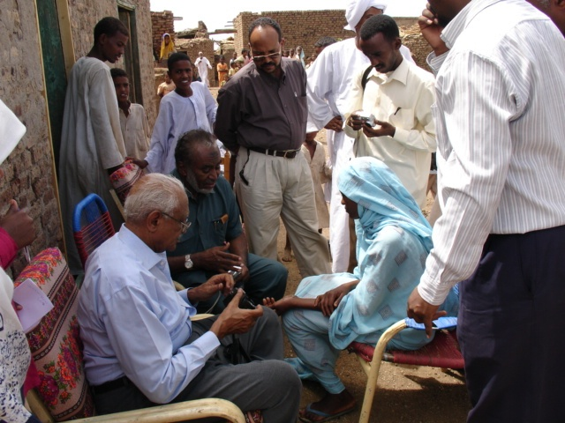
Examining a female patient with M. mycetomatis in the hand at a village in Eastern Sinnar

Slide 25
Mycetoma In The White Nile
Prof Fahal discovered a focus of M. mycetomatis eumycetoma in the White Nile State about 250 Km south of Khartoum
He established a clinic and surgical theater in one of the villages
70 patients were surgically treated
All biopsies were reported by my lab in Khartoum

Slide 26
Main Agents Causing Mycetoma
In The Sudan
Eumycetoma
  Madurella mycetomatis
Actinomycetoma
  Streptomyces somaliensis
  Actinomadura madurae
  Actinomadura pelletieri

Slide 27
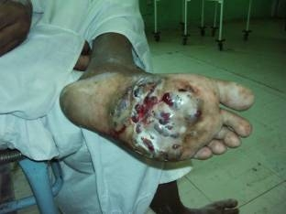
Foot mycetoma
The diagnostic triad:
Swelling
Sinuses
Discharge containing grains
In M. Mycetomatis Grains Are Black

Slide 28
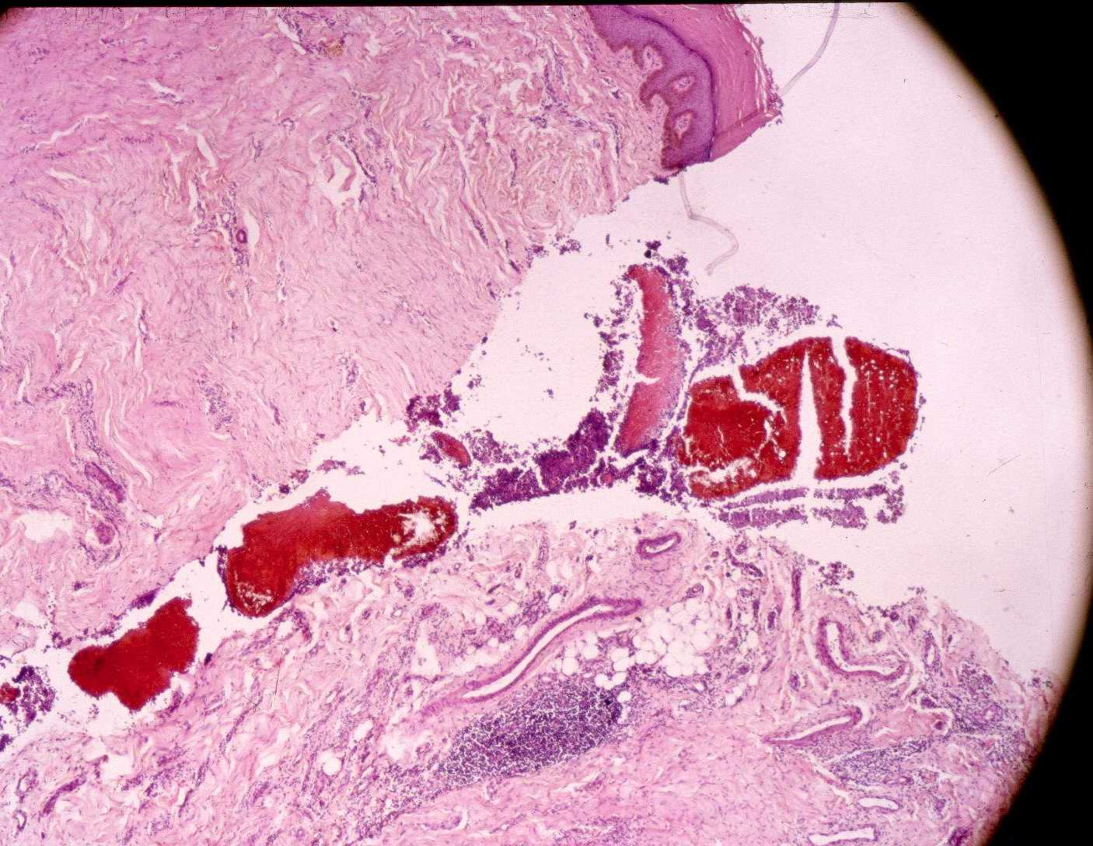
Pathology of Mycetoma
Sinus track discharging black grains of
M. mycetomatis

Slide 29
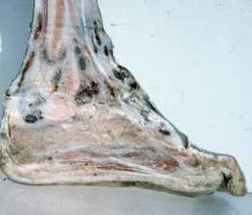
M. mycetomatis of the foot and leg
M. mycetomatis involving the foot and the lower third of the leg.
In this longitudinal section, the black fungal grains are spreading in the tissues including bones.

Slide 30
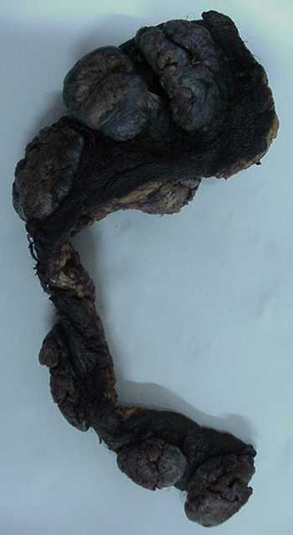
The spread of mycetoma
Mycetoma may spread like a malignant tumour:
    Locally
    By lymphatics
    Rarely through blood vessels
Opposite is spread of M. mycetomatis from the foot to inguinal lymph nodes

Slide 31
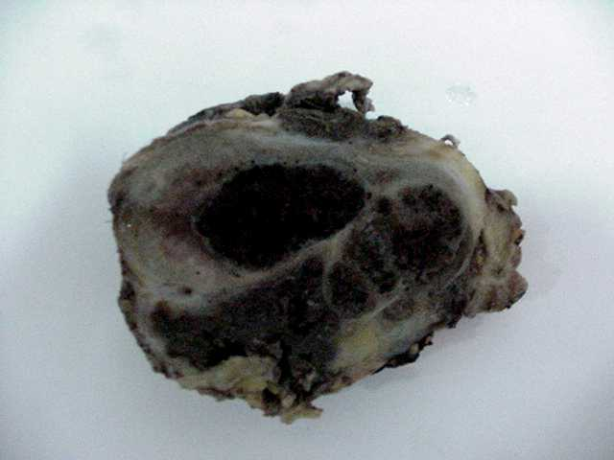
Lymphatic spread of mycetoma
Enlarged inguinal lymph node containing grains of
M. mycetomatis

Slide 32
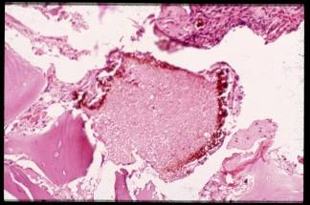
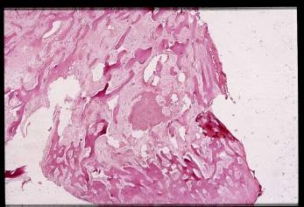
Bone lesions in M mycetomatis
Bone lesions in M. mycetomatis eumycetoma
A grain in a cavity within bone
Reactive bone around a grain

Slide 33
Differential diagnosis of mycetoma
The differential diagnosis includes some tumours such as Kaposi sarcoma and malignant melanoma.
Any subcutaneous mass such as thorn and foreign body granulomas, particularly in areas endemic for mycetoma, may simulate mycetoma.
Bone lesions may be confused with osteosarcoma and chronic osteomyelitis.

Slide 34
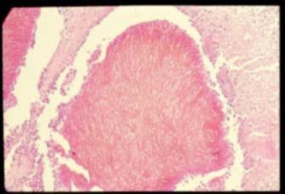
Madurella mycetomatis
Madurella Mycetomatis
There are two types of grain: filamentous and vesicular
This is a histological section of filamentous type of grain of M mycetomatis.
The hyphae are embedded in cement substance containing a brown pigment

Slide 35
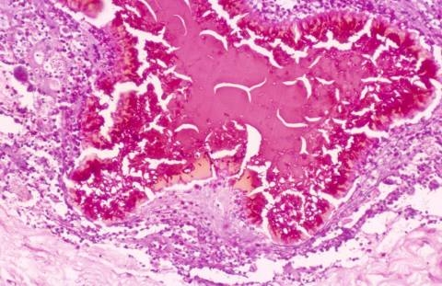
Madurella mycetomatis
Madurella Mycetomatis
A vesicular type of grain of M. mycetomatis.
The hyphae are mainly in the periphery of the grain and are swollen, hence the term vesicular.

Slide 36
Classification of host reaction
Classification of Host Reaction
Type I:
    Central neutrophils zone around grain
    Middle macrophage zone
    Peripheral lymphocyte/plasma cell zone
Type II:
    Macrophage/giant cell zone around grain
    Lymphocytes/plasma cells in the periphery
Type III:
    Epithelioid granuloma

Slide 37
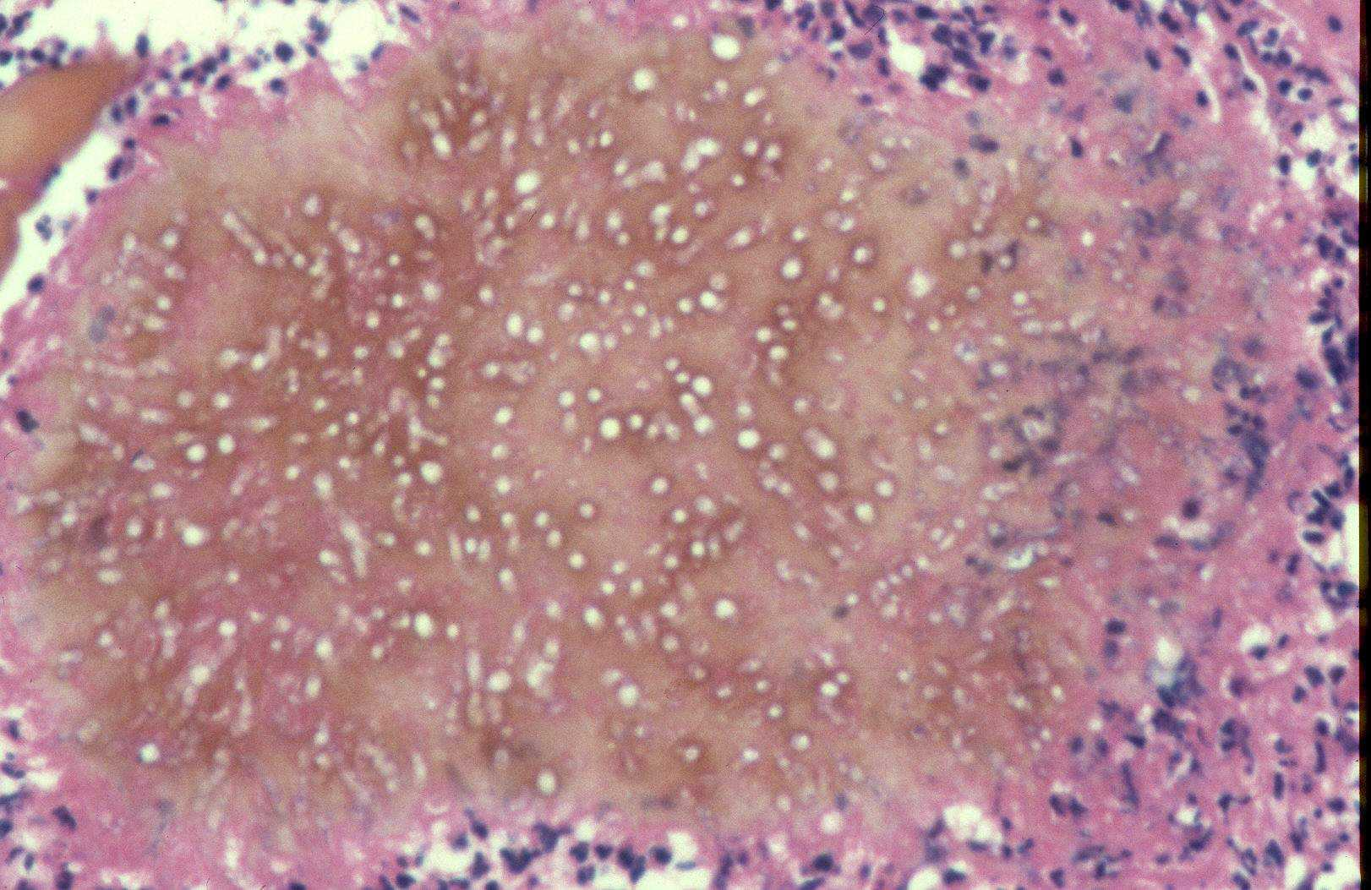
Pathology of mycetoma
Pathology of Mycetoma
Neutrophils around a grain of M. mycetomatis

Slide 38
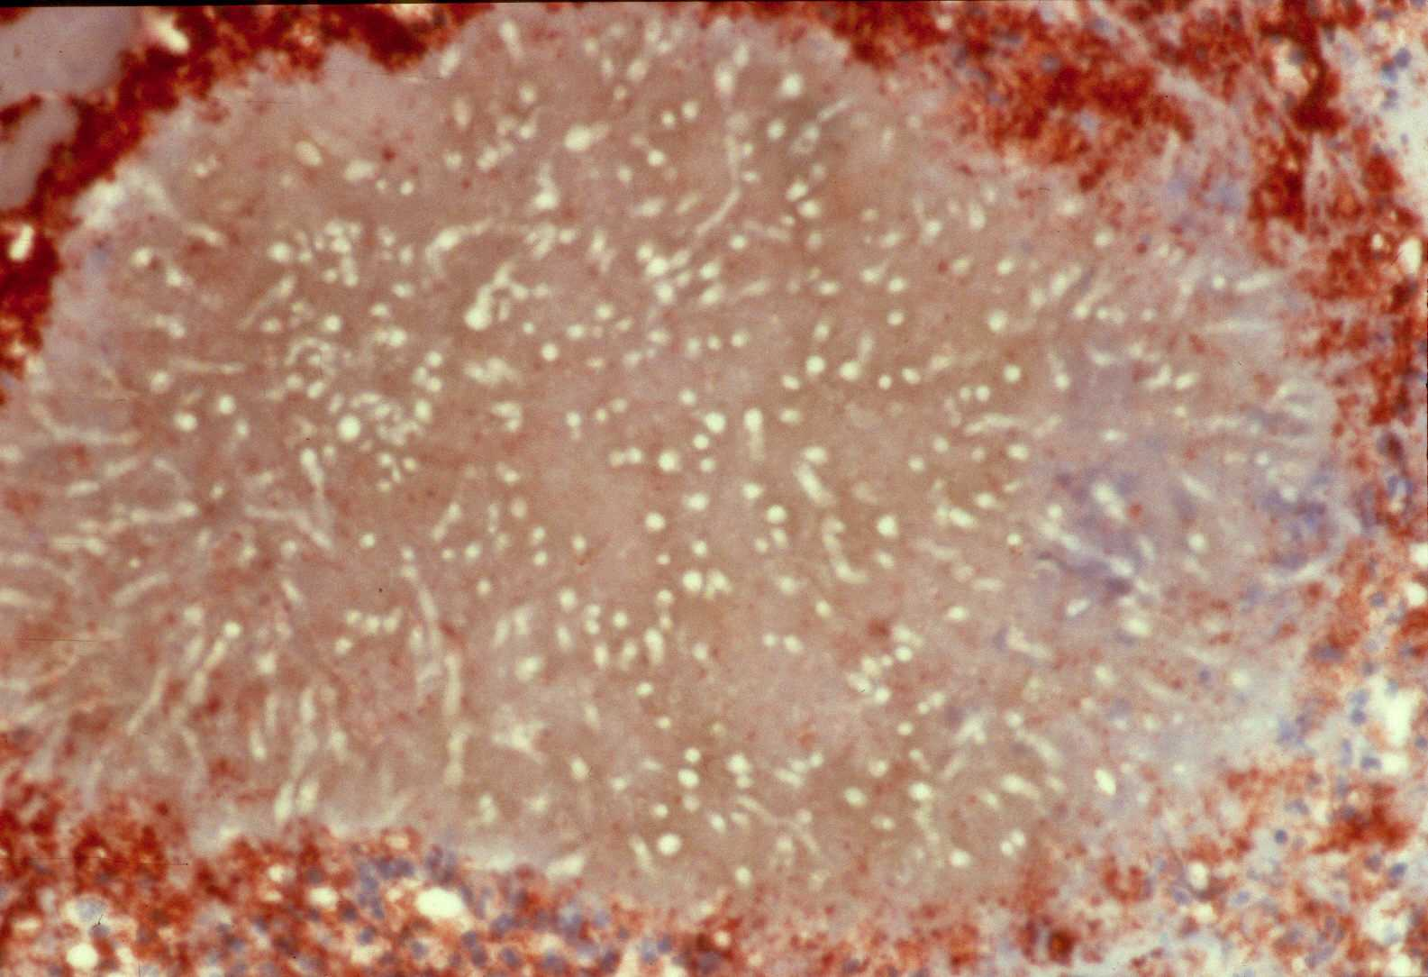
Pathology of mycetoma
Pathology of Mycetoma
CD-15 positive neutrophils around a grain of
M. mycetomatis. Alkaline phosphatase stain

Slide 39
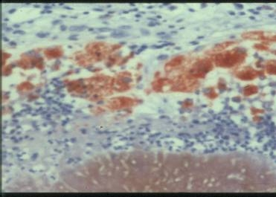
Inflammatory reaction around a grain of M. mycetomatis
(Type I Reaction)
Part of a grain surrounded by a layer of neutrophils.
Outside this is a zone of CD 68 +ve macrophages.
They stain a brown colour. (Immunoperoxidase stain)
Part of peripheral zone just visible at the top

Slide 40
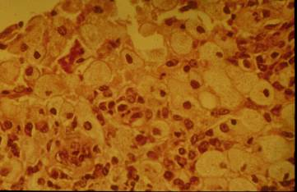
Host reaction in M mycetomatis
Host Reaction in M. Mycetomatis
Lipid-containing foamy macrophages outside the neutrophil zone
Lipid is most likely derived from the grain since they too contain lipid as will be shown later

Slide 41
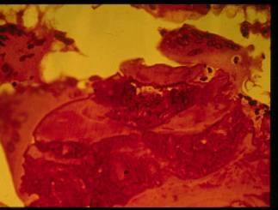
Host reaction: type II reaction
Host Reaction:
Type II Reaction
Type II reaction is characterized by the replacement of the neutrophil zone by macrophages and giant cells.

Slide 42
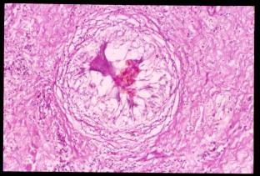
Host reaction: type II reaction
Host Reaction:
Type III Reaction
Type III reaction.
Epithelioid granuloma.
In the centre is a remnant of pigment.

Slide 43
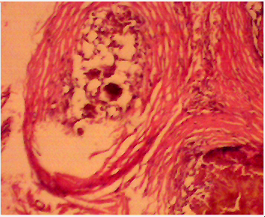
Fibrosis particularly after antifungal treatment
is a feature of M. mycetomatis
Arrows point to bands of fibrous tissue

Slide 44
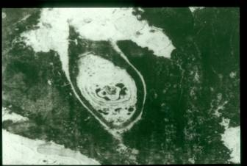
M. Mycetomatis : Electron Microscopy
Cement substance surrounding the fungus.
The latter shows the growth of hypha within hypha as indicated by the curved lines.
The black material in the cement substance and around the hyphae is melanin

Slide 45
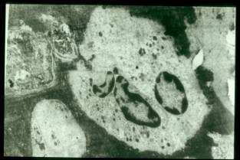
M. Mycetomatis : Electron Microscopy
A neutrophil (arrow) has penetrated deep within a grain

Slide 46
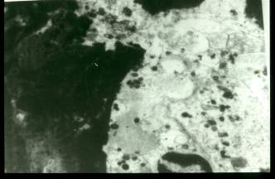
M. Mycetomatis : Electron Microscopy
A neutrophil adhering to the surface of the grain.
Note the granules of the neutrophil are being discharged into the grain.

Slide 47
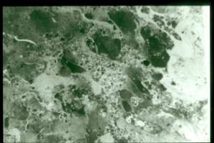
M. Mycetomatis : Electron Microscopy
The grain has now fragmented as a result of the action of the neutrophils
Neutrophils are the first cells that damage grains and they die in the process
They are followed by the scavenger macrophages which clear the debris

Slide 48
M. Mycetomatis Pathology
Despite the fact that some grains are completely destroyed by neutrophils these do not completely destroy all grains in symptomatic patients
We do not know if in endemic areas some patients may succeed in completely eradication the disease
There is a need to address this issue by further studies

Slide 49
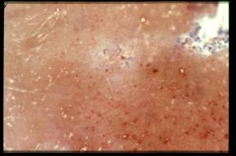
Host Reaction: IgG in a Grain
IgG coating fungal hyphae.
Immunoperoxidase stain.

Slide 50
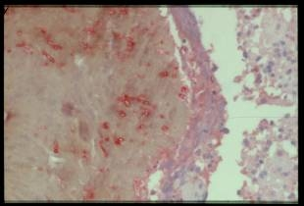
Host Reaction: Complement in a Grain
Complement component CD3 on the surface of the grain and intact hyphae within the grain.
Immunoperoxidase stain.

Slide 51
Mycetoma Pathology
I shall show later that the deposition of immunoglobulins and the activation of complement is on the melanin layer on the surface of hyphae
Thus lysis of hyphae by complement does not appear to destroy the grain
Complement attracts neutrophils which can do the job committing suicide as they destroy the grain

Slide 52
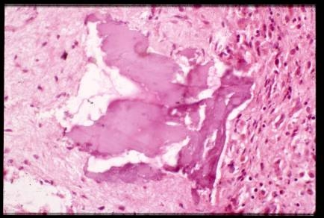
Bone lesions in M mycetomatis
Bone Lesions
in M. Mycetomatis mycetoma
Sequestrum in the bone

Slide 53
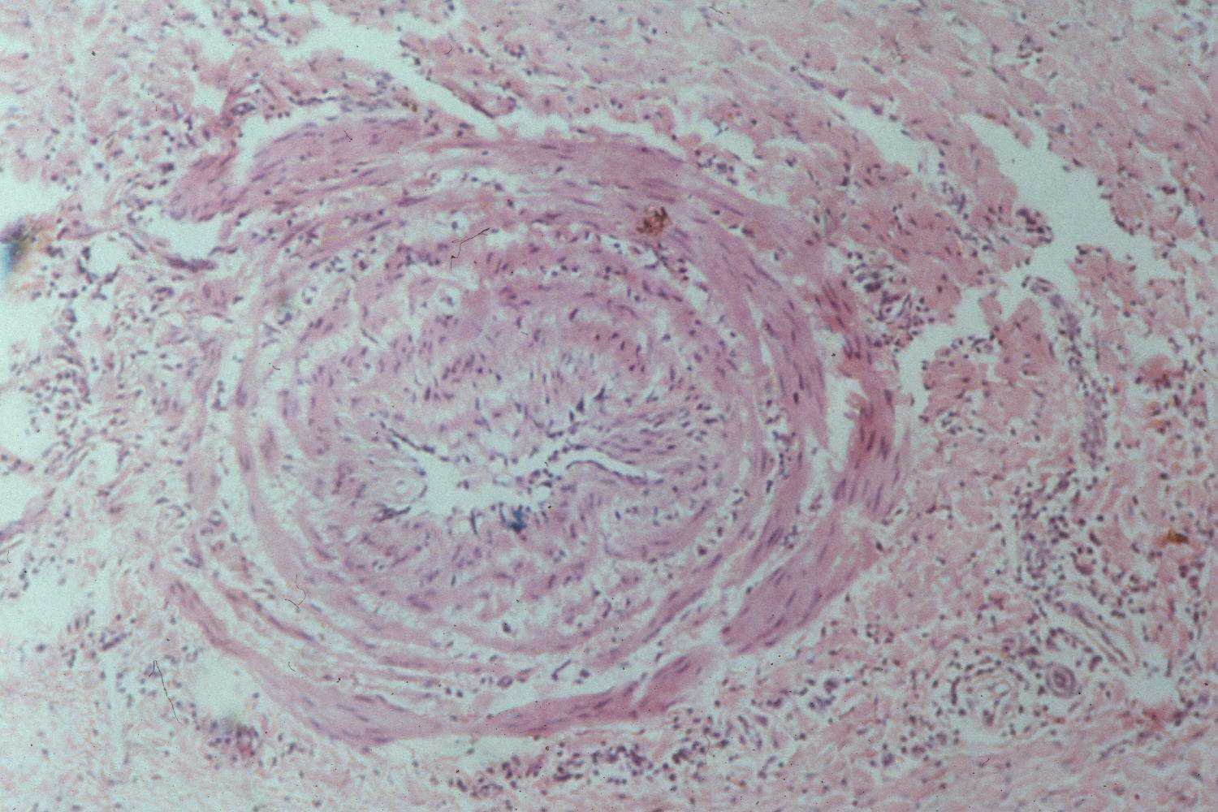
Vascular changes in mycetoma
Vascular Changes In Mycetoma
A vein with a narrow lumen and thick muscle layers

Slide 54
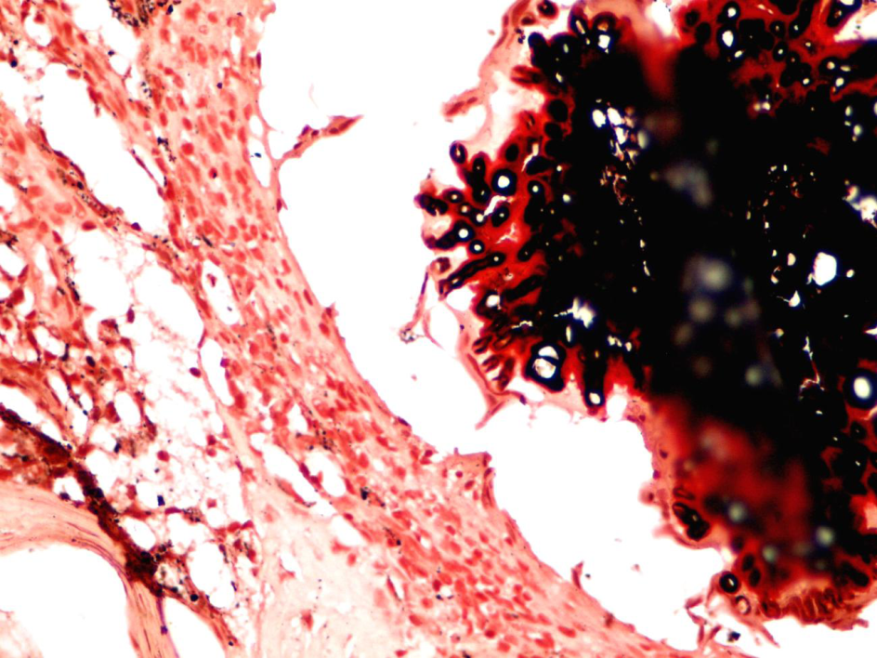
Exploration of the structure of M. mycetomatis:
Melanin
Photomicrography shows melanin in the grain
The hyphae at the periphery of the grain are covered with melanin
Masson-Fontana stain for
melanin x40).

Slide 55
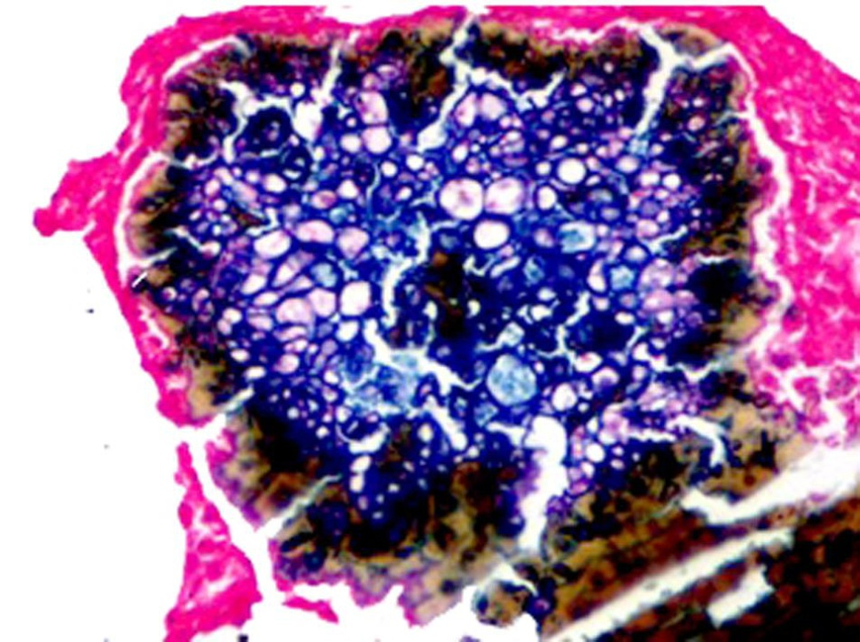
Exploration of the structure of M. mycetomatis:
Melanin
photomicrography shows cements substance and hyphae staining
a blue colour with
Schmorl’s stain for
melanin
(Schmorl’s stain x40).

Slide 56
Function of melanin
We have shown here that complement activation occurs in grains but there is no direct damage to the hyphae because the activation occurs on the melanin layer
However, activated complement attracts neutrophils which damage hyphae by their strong enzymes concentrated in the neutrophil granules.

Slide 57
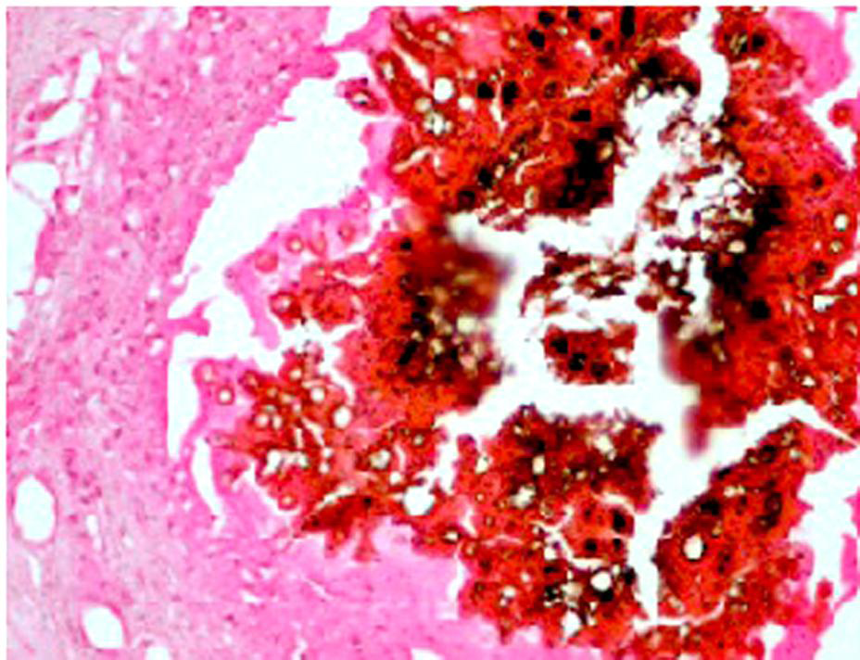
Calcium in the grain
Calcium in the grain
Photomicrography shows the hyphae and cement substances are positive for calcium
(Von Kossa stain x40).

Slide 58
Biochemical studies of grains from 80 patients infected with M. mycetomatis
Both grains and cultured hyphae were negative for sugars
Both tests for protein and Sudan ΙΙΙ test for fat were positive with both the grains and cultured mycelia.
This may indicate that fungal grain consisted mainly of fat and proteins.

Slide 59
Concentration of metals in grains
Atomic Absorption Spectrophotometry (AAS) was used to determine the concentrations of several metals in the grains and the surrounding tissue and the controls.
The concentrations of Cu, Zn, and Ca in the grains were four, six and sixteen times higher respectively than in normal control tissues (p<0.05).
There were no significant differences in the Fe, Ni and Co concentrations between the patients and control, (p>0.05).

Slide 60
Function of melanin
Proteins and lipids are known to contribute to the virulence of some fungi.
M. Mycetomatis most probably uses this melanin as a protective mechanism which enhances the fungal survival.
This is in line with that reported by behnsen who suggested that, the fungal melanin protects the fungi from various host defense mechanisms such as the hydrolytic enzymes, free radicals, redox buffering,
and from the host defensive proteins such as antibodies and complement by binding them with melanin or by polymerized melanin covering cell wall linkages

Slide 61
Function of melanin
The M. mycetomatis melanin also acts as an anti-oxidant agent and it resists the antifungal effects of Ketoconazole and Itraconazole.
This is documented by the fact that, adding isolated melanin to the culture medium results in elevation of the minimum inhibitory concentrations of these antifungal agents.

Slide 62
The mean values of the heavy metals concentrations in the patients’ biopsies & the control
Metals | Normal tissue (Mean/ppm) | Grains Mean/ppm
Cu | 0.04 ± 0.018 | 2.7 ± 1.15
Zn | 0.34 ± 0.1 | 7.6 ± 4.8
Ca | 1.20 ± 0.15 | 52.1 ± 17.6
Fe | 4402.9 ± 336.7 | 6795.4 ± 2753.9
Pb, NI, Co were not detected in normal tissue and grains

Slide 63
Treatment of eumycetoma
Madurella mycetomatis is the most common aetiologic agent of eumycetoma worldwide.
Treatment of this infection is very difficult and associated with high recurrence rates and low cure rates.
Currently the treatment consists of a combination of surgery and antifungal therapy. Antifungal therapy is usually given for at least one year.

Slide 64
Treatment of eumycetoma
The commonly used antifungal ketoconazole is too expensive for many patients in endemic countries and has many side effects.
A study evaluated the in vitro activity of the new antifungal agent ravuconazole against M. mycetomatis.
The drug showed excellent in vitro activity against all tested strains and its prodrug, E1224, might be a potential new therapeutic option for eumycetoma caused by M. mycetomatis.

Slide 65
Treatment of eumycetoma:
Artemisinin was not active against M. mycetomatis, but tea tree oil did inhibit its growth.
Since tea tree oil's prime component easily penetrates the skin, tea tree oil could be a useful agent in the treatment of Eumycetoma.
Artemisinin & tea tree oil in the treatment of eumycetoma:
in vitro test

Slide 66
References
van de Sande WW, Luijendijk A, Ahmed AO, et al. . Testing of the in vitro susceptibilities of Madurella mycetomatis to six antifungal agents by using the Sensititre system in comparison with a viability-based 2,3-bis(2-methoxy-4-nitro-5-sulfophenyl)-5-[(phenylamino)carbonyl]-2H-tetrazolium hydroxide (XTT) assay and a modified NCCLS method. Antimicrob Agents Chemother 2005;49:1364-8.
Wendy W. J. van de Sande1, Ahmed H. Fahal, Thomas V. Riley, Henri Verbrugh and Alex van Belkum.1093. In vitro susceptibility of Madurella mycetomatis, prime agent of Madura foot, to tea tree oil and artemisinin Antimicrob. Chemother. (2007) 59 (3): 553-555. doi:

Slide 67
References
3. Fahal AH, El Hassan AM, Abdelalla AO, Sheik HE, Cystic mycetoma: an unusual clinical presentation of Madurella mycetomatis. Trans R Soc Trop Med Hyg. 1998; 92:6-67.
4. EL Hassan AM, Fahal AH, EL Hag IA, Khalil EAG. The pathology of mycetoma: Light microscopic and ultrastructural features. Sudan Med J. 1994; 32: 23-45.
5. Fahal AH, EL Toum EA, EL Hassan AM, Gumaa SA, Mahgoub ES. A preliminary study on the ultrastructure of Actinomadura pelletieri and its host tissue reaction. J Med Vet Mycol. 1994; 32: 343-348.PMID: 7844700.
6. Fahal AH, Sheikh HE, EL Hassan AM. Pathological fracture in mycetoma. Trans R Soc Trop Med Hyg. 1996; 90: 675-676.PMID: 9015513.
7 .Fahal AH, Sharfi AR, Sheikh HE, EL Hassan AM. Mycetoma: Uncommon complication. Trans R Soc Trop Med Hyg. 1996; 89: 550-552.

Slide 68
References
Ahmed AO, Mukhtar MM, Kools-Sijmons M, Fahal AH, de Hoog S, van den Ende BG, Zijstara, ED, Verburgh H, Abugroun ESA, EL Hassan AM, van Beklkum A. Development of a species-specific PCR RFLP procedure for the identification of Madurella mycetomatis. J Clin Microbiol. 1999; 37(10):3175-8.PMID: 10488173. [
EL Hassan AM, Fahal AH, Ahmed AO, Ismail A, Veress B. The immunopathology of actinomycetoma lesions caused by Streptomyces somaliensis. Trans R Soc Trop Med Hyg. 2001: 95(1); 89-92.PMID: 11280076
EL Hassan AM, Fahal AH, Veress B. Cell phenotypes, immunoglobulins, and complement in lesion of eumycetoma caused by Madurella mycetomatis. Sud J Dermato 2006; 4 (1):2-5.
Fahal AH, Rahman I A, El-Hassan AM, EL Rahman ME, Zijlstra EE. The efficacy of itraconazole in the treatment of patients with eumycetoma due to Madurella mycetomatis. Trans R Soc Trop Med Hyg. 2011; 105(3):127-32.
Hmed Mohamed EL Hassan, Ahmed Hassan Fahal Wendy W van de Sande. A histopathological exploration of madurella mycetomatis grain. Plos/one 2013. DOI 1371/Journal pone 0057774

Slide 69
References
Mahgoub E, Murry Ian. Mycetoma 2nd Edition
Mehta Publishers. Mehta House A-16. Naralna. Phase II. New Delhi-110028
Mycetoma Research Center, University of Khartoum website:
www.mycetoma.edu

